Slide 1

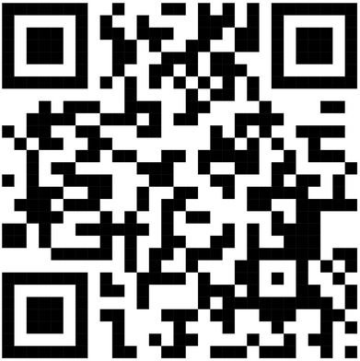
LARK FINSERV
LOAN AGAINST
MUTUAL FUNDS

Slide 2
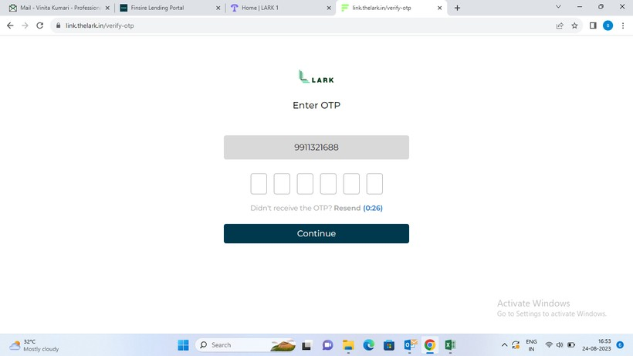

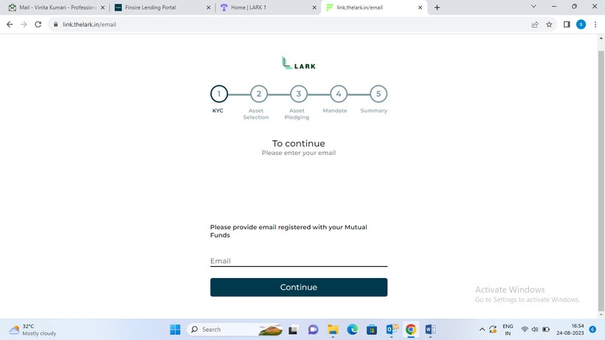
LENDING PROCESS
1.
Mobile number OTP based verification:
2. Email to be provided which is registered with the MF Schemes and to be verified using an OTP:

Slide 3
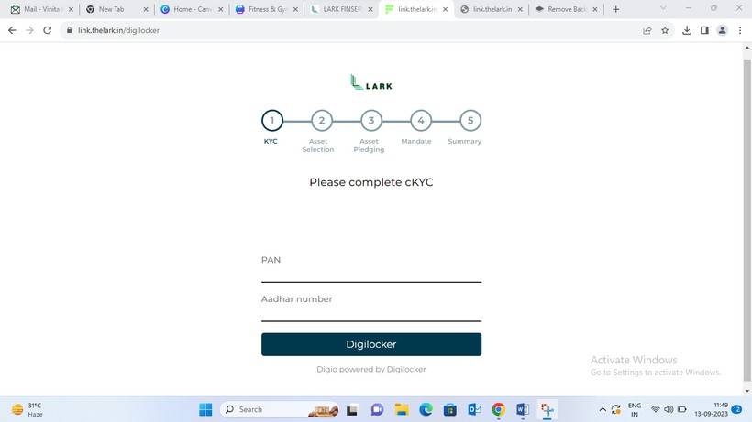
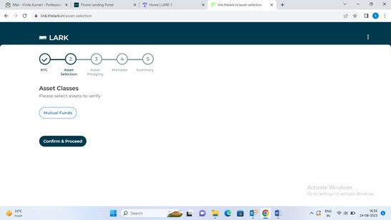

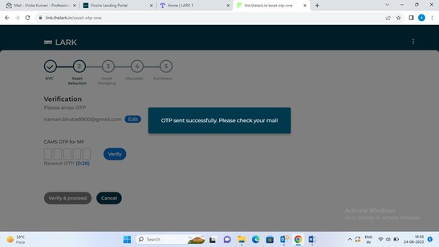
3. KYC using Pan & Adhaar with OTP verification
4. Selection & Fetching of Assets to be Pledged
Selection of Assets to be pledged
Fetching of Assets

Slide 4
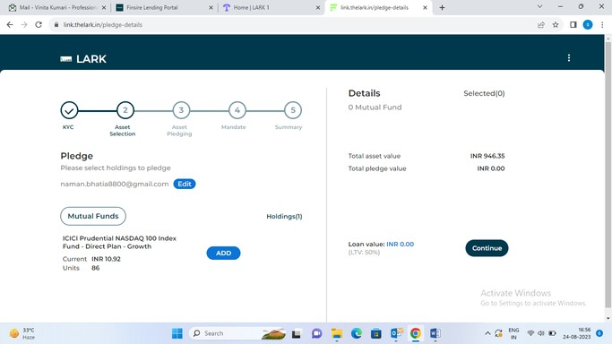

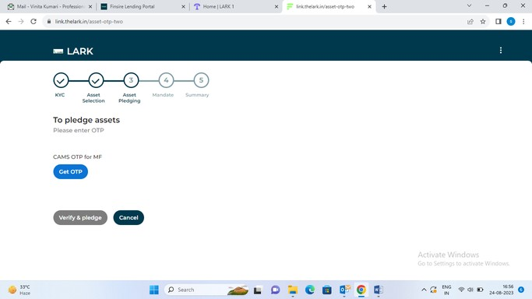

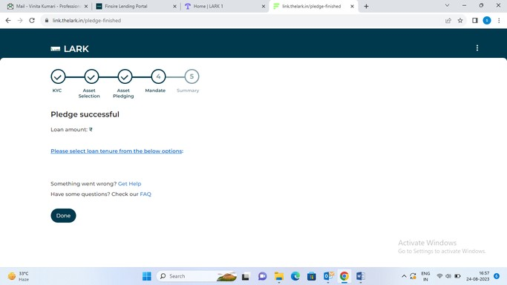
5. Pledging of asset with otp verification:
Pledging of your Mutual Funds
OTP Verification
for Pledge confirmation

Slide 5
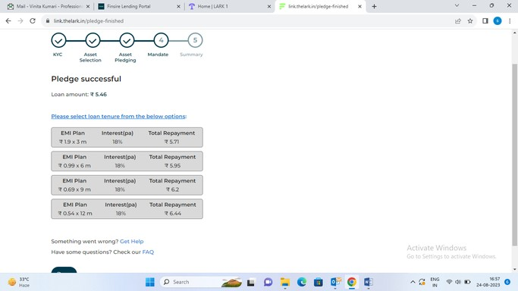
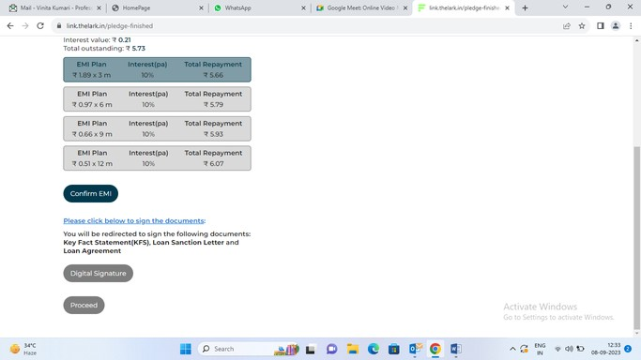

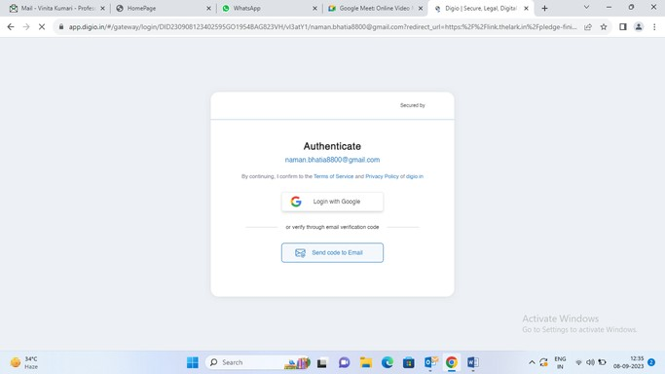
6. Selection of EMI options:
7. E-Signing of Lark Loan Agreement
Click for Loan Agreement

Slide 6

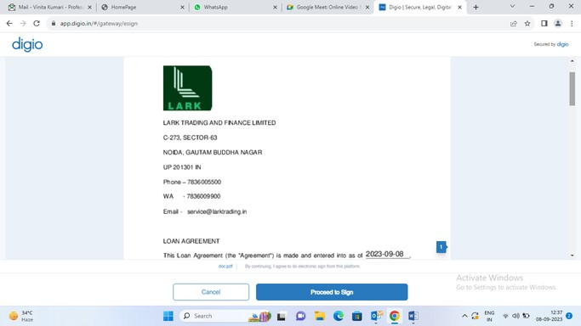
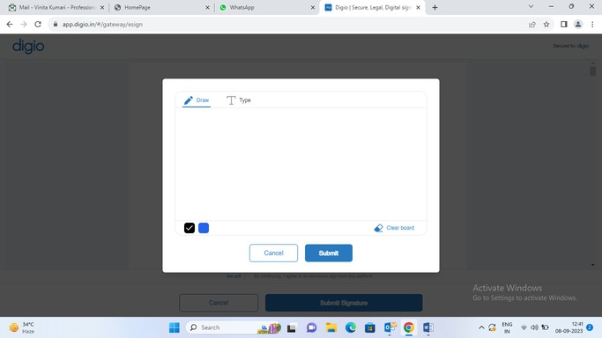
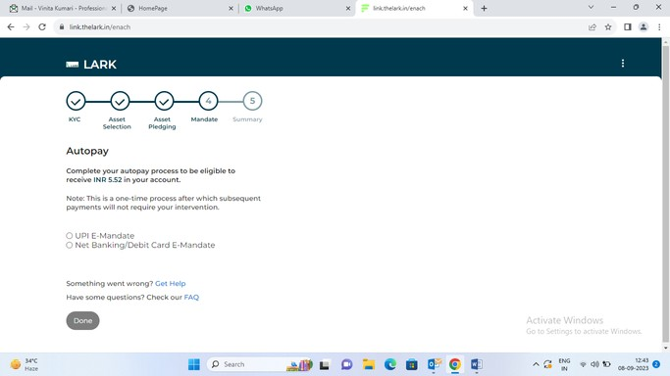
Digitally signing the Loan Agreement
8. Payment options- UPI E-Mandate and Net Banking / Debit Card

Slide 7
THANK YOU

